Slide 1
UNCC_WORK Prototype Status Review
Damian Hupka, Zachary Zaleski, Nathan Pecoraro, William Clampett, Duncan Tennant

Slide 2
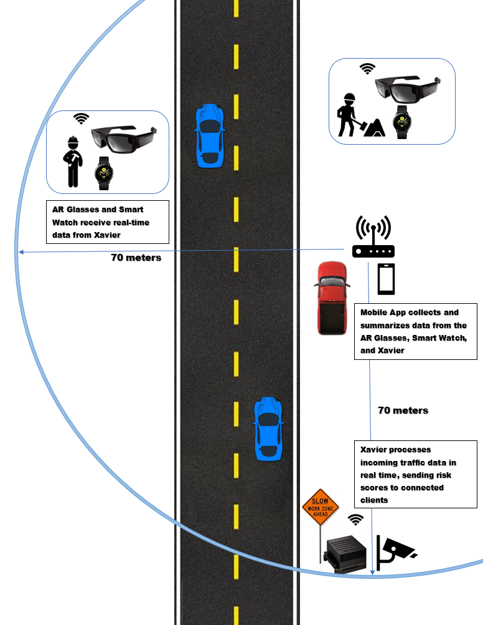
System Overhead
Notes:
Deliverable -- Server Communication between devices to represent a single-scale system of one person, also a digital twin application to collect and summarize data, to be stored in a database and communicated to the server for an updated risk score.
Currently, system is implemented for one person. Our goal is to maximize the efficiency of our system implementation by way of error handling to ensure fluid communication with the purpose of scaling to multiple people (goggles, watch, etc)
The image above shows the system operating in a theorized workzone. The NVIDIA Xavier board is operating as a server and will be placed near the edge of a work zone connected to a camera which will be analyzing traffic data in real time to provide a risk score. (Currently, we are generating this risk score to ensure server functionality)
This risk score will be communicated to the various clients that are connected to the server by means of wireless communication using an access point to interface between devices which is operating on a LAN network.
The mobile app will be collecting and summarizing data from the server and clients to be displayed under a managerial context.
The risk score that is delivered to the clients will be displayed in real time for a warning system on the device to notify the user.
The system’s operating distance has currently been measured to be 70m with the access point in a centralized location
This operating distance was measured in near ideal circumstances, the team will continue to test the system in more accurate to a work zone conditions to ensure fluid communication
Each of the devices in the system exhibit various hardware issues that may cause risks within the system.

Slide 3
Associated Hardware Risks & Management
Risks | Risk Mitigation
When testing, the battery appeared to last approximately 40 minutes as opposed to the 4-6 hours of battery life that is expected | Potentially replacing goggles would be a short term solution, however it is being discussed as to whether this will be viable as a solution for potential companies looking to invest in this project
Large vehicles and traffic appear to cause much higher latencies or halt communication altogether when passing by. (buses, large trucks, etc.) | Error handling can be done to mitigate the effects of outside vehicles in the workzone
Working near the boundary or outside the temperature range of the router has shown to reduce the range of communication | Keeping the router in a temperate zone well within its range of operation would allow for the most efficient communication
Notes:
Zach
What we have here is the associated risks with the hardware. Dealing with these could be difficult due to the nature of the project, but we also have plans to mitigate them should they appear
Goggles: To start with, when testing, the goggles have had a notably shorter battery life than advertised. The glasses have gotten to a point where they are inoperable in as little as 40 minutes. This is significant because any battery level below 40% will make communication with the goggles difficult to connect at any distance (even right next to it). A notable way to address this would be to purchase a replacement pair of the goggles. This would most likely be a short term solution which may not be feasible for potential construction companies looking to invest in this technology.
Traffic: Next, Larger vehicle such as vans and trucks seem to block the connection entirely. This has shown to lead to much higher latencies which could potentially result in injuries for workers. Vans and trucks passing by would be a common occurrence in a highway work zone so this is issue is somewhat unavoidable. Implementing error handling on the client and server side to reduce the risk of dropping connection in these scenarios will be done to potentially mitigate this.
Temperature: Finally, recently during our testing we noticed that the temperature can have a massive effect on the efficiency and range of communication between devices. At the beginning of February the team was testing outside in temperatures around 35 degrees and could only successfully connect at a range of approximately 40 meters. When we had done testing on a more temperate day of around 60 degrees, the range was approximately 70 meters which is a 75% increase. Because of this, attempts to keep the router in a temperate zone should be made on a work site
The figure on the previous slide showed a broad overview of the setting that the system may be operating in and where the various devices will be placed. The following slides will move into the topology in which communication and data transfer is occuring

Slide 4
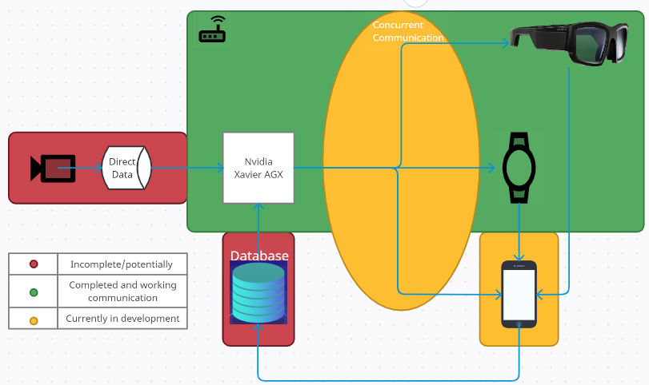
Communication Schematic and Progress
Notes:
Zach
This is the current communication schematic displaying progress and development with completed items being in the green section, items in development are in the yellow bubbles, and incomplete or unaddressed sections are in red
The team has a working server for communication between the Vuzix Blade Goggles, Smartwatch, an android device client, and the communication for the mobile application is in progress. Various server designs are similarly in progress.
Similarly, the mobile application writing the various aggregated or summarized data to a local database, which will be communicated back to the server for an updated scale of the risk score is incomplete, but development will occur soon. (For example, if a worker is near the edge of a work zone as noted by the GPS location, the potential hazards may be higher, so the server will communicate larger risk scores back to the clients)
Server design implementation will be sending a randomly generated risk score to the clients. However, with sufficient knowledge the team will implement the server (Xavier) receiving real time traffic video from a connected camera and the Xavier will use this data and an associated deep learning model to conduct inference on vehicle trajectory to be used in previously mentioned risk score generation. However, this is not currently in progress from the team as implementing the absolute communication scheme is the primary deliverable for development here

Slide 5
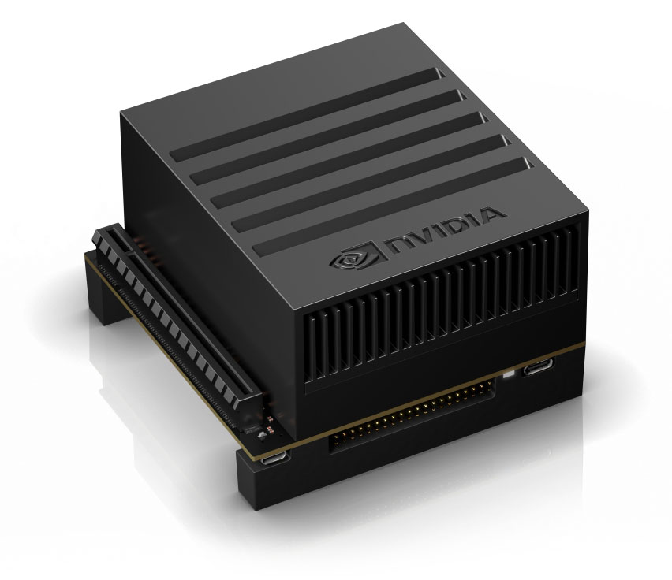



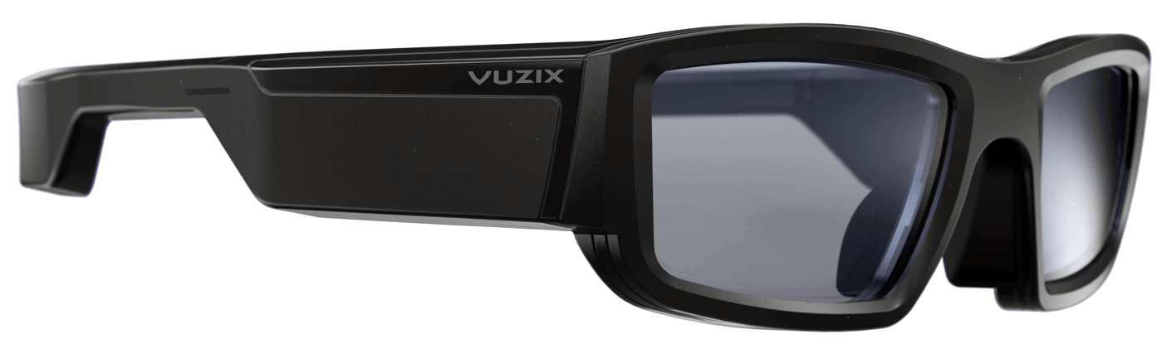
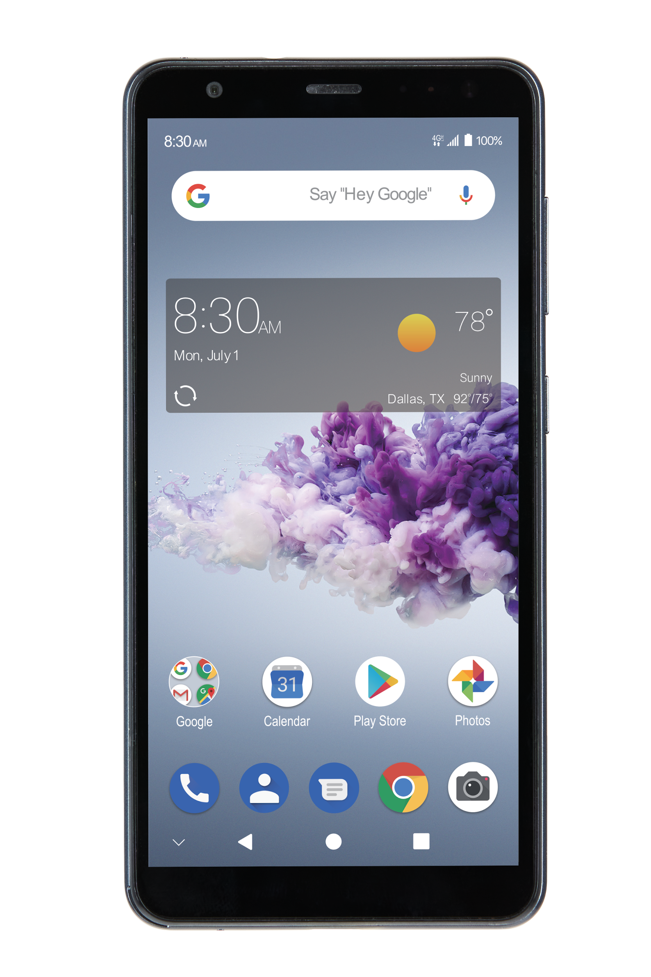
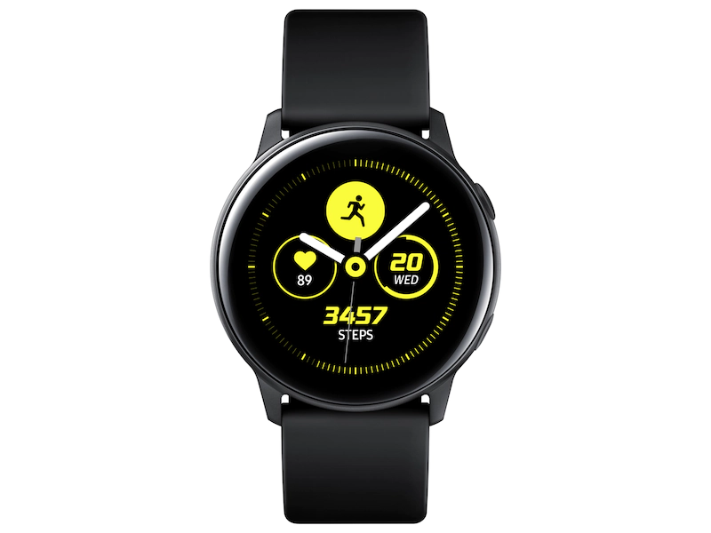

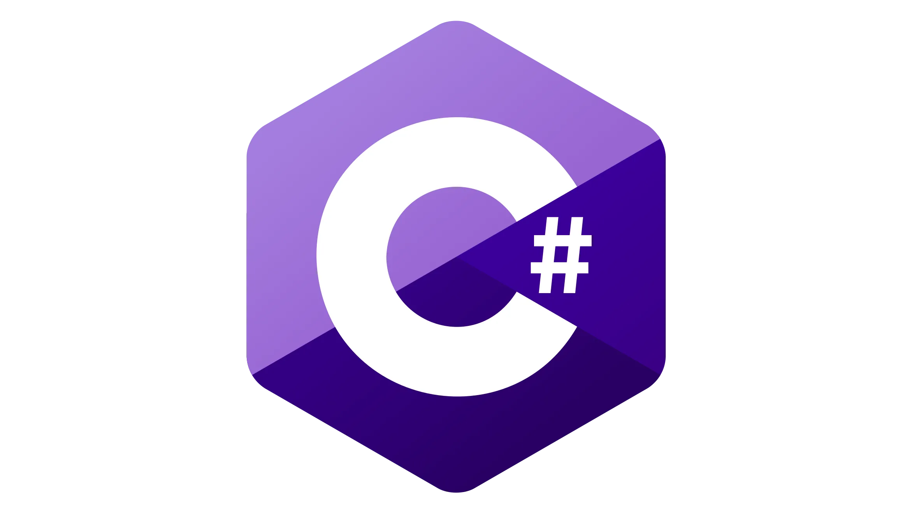
Software being used for development
Server:
Client:
Client (digital twin):
Client:
Notes:
Zach
Server: Developed in Python, utilizing the low-level networking interface Sockets package. This was chosen due to comprehensive available documentation, and most closely aligned with the system design team’s relevant experience. However, as the team is shifting into a multithreading approach it is becoming apparent that sockets may be difficult to reach the desired, error handled solution, but the team will reach this goal after further research.
Clients (Goggles, Phone): Developed in Java using the Android Studio IDE, similarly utilize sockets for network interfacing
Client (Watch): Developed using the native Tizen Studio Framework IDE for API usage, software developed using C#.
The team has experienced difficulty in establishing communication between each of these different languages as communication is handled slightly differently across them.
The clients thus far have been largely developed by Sep, however, the team is leveraging the existing client communication backend to implement on the digital twin, and is leading development on mobile application progress. The system design team has been honing in on optimizing the server design.

Slide 6
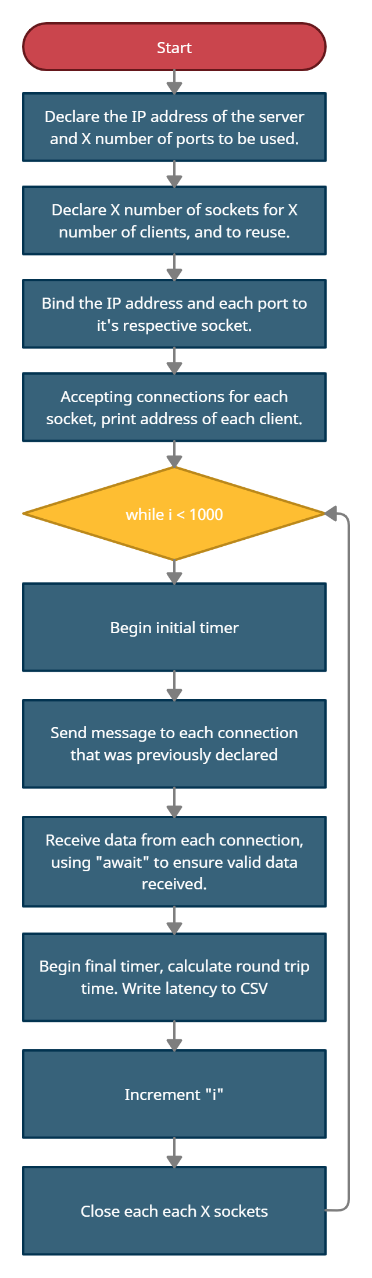
Current Server Implementation for Testing
Notes:
Nathan
Single-thread, multi-socket, multi-port - Not ensuring messages are sent concurrently
This implementation has been used to gather information on the latency between available devices and potential difficulties between specific devices
Risks associated with this implementation: Although multithreaded server has yet to be strenuously tested, it is likely that with this implementation the scalability of the system is largely decreased due to the number of sockets and ports being used
Furthermore, difficult to implement sophisticated error handling in communication. Mostly relying exclusively on the clients to do any error handling, but this is not accounting for the server hanging on a transmission

Slide 7
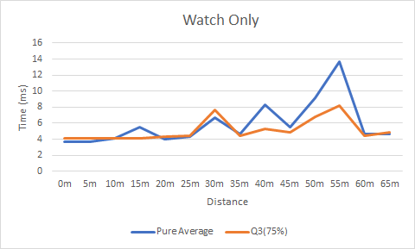
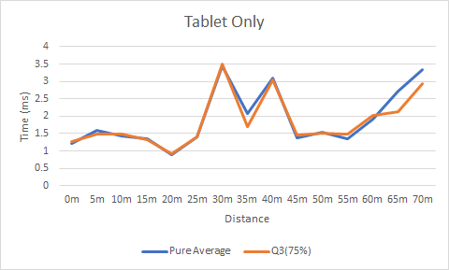
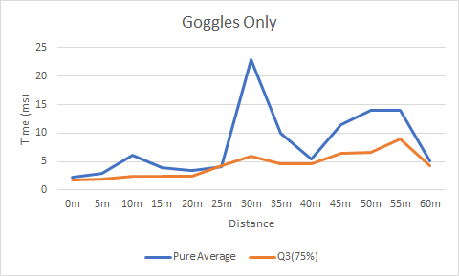
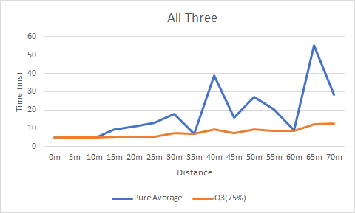
Latency Data and Anomalies
Notes:
Nathan
Q3 Shows what we can idealistically get with error handling, which even with all 3 devices is averaging around sub 10ms at maximum distance

Slide 8
Server Implementation Milestones
The primary objective the team currently has in implementing the server is to design an multithreaded server approach to ensure adequate error handling, concurrent message transmission, and fluid communication wholly
The team has a theorized and began testing a couple of potential frameworks for the flow of the server
The following slides will discuss these implementations in detail
Notes:
-Nathan

Slide 9
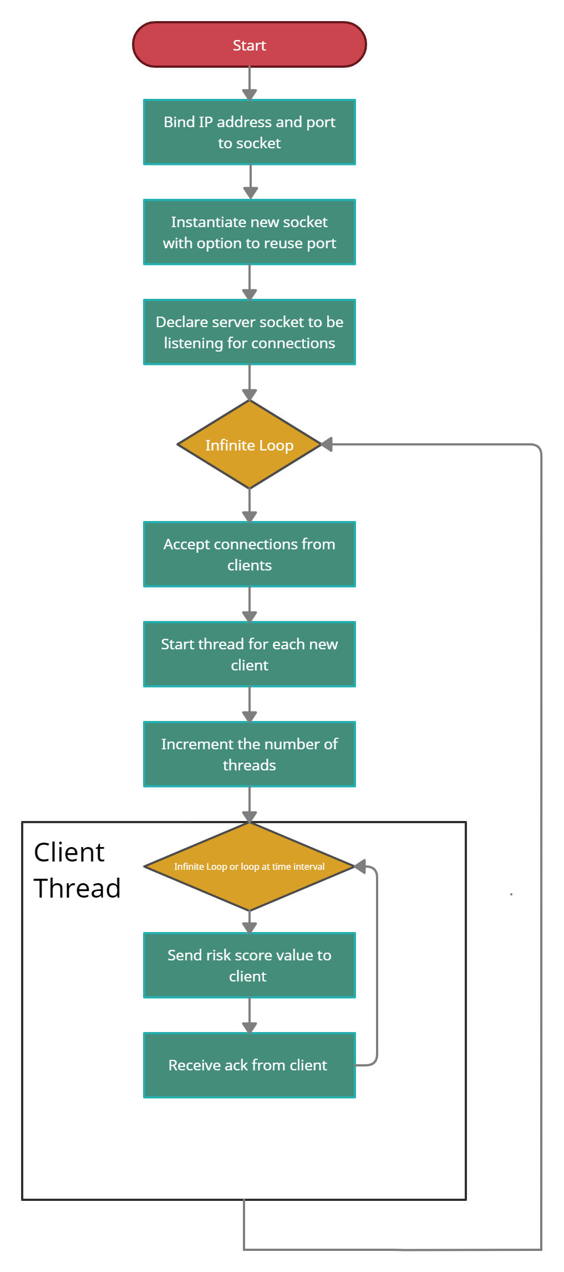
Initial Multithreaded Server Design
Notes:
The team implemented and briefly tested this approach. The server is able to concurrently send messages to X # of connected clients, and receive a message back from each of these clients
This implementation utilizes a single client thread which will infinitely deliver messages to the respective connected client, and receive a message back (ideally for acknowledgement that the message was received correctly)
-Damian

Slide 10
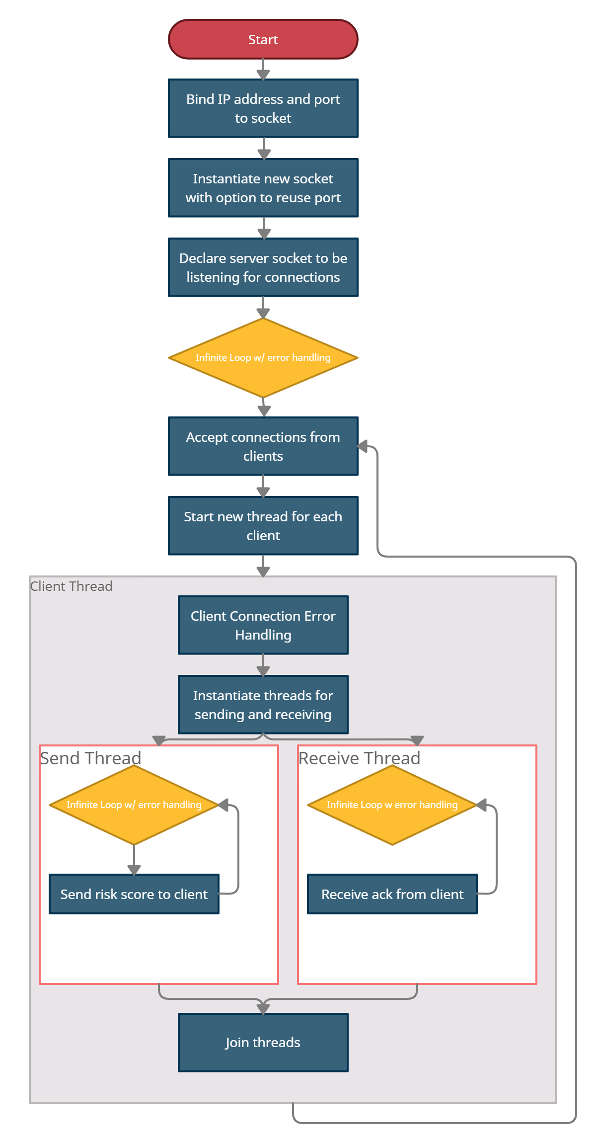
Theorized Multithreaded Server Design
Notes:
This implementation is what the team has theorized to be a more sophisticated implementation of the server that will greater lend itself to ease of execution
This design utilizes three threads; wherein, a new thread will be started for each client which will handle any potential connection issues, a thread for infinitely
-Damian

Slide 11
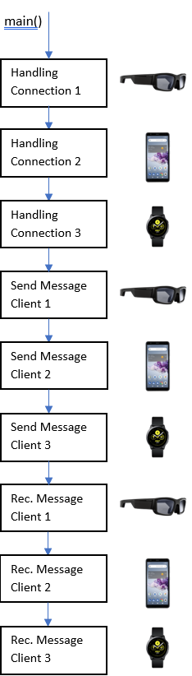
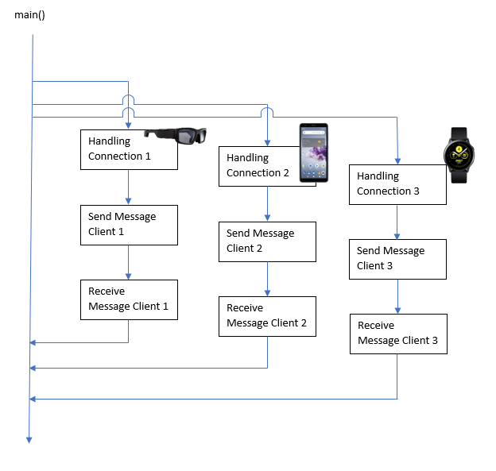
Server Design Visual Comparison
Single-Threaded:
Multi-Threaded:
Notes:
Notes: demonstrates concurrency
-Damian

Slide 12
Server Design Feasibility & Performance Comparison
Single-threaded
Multithreaded
Useful in establishing baseline RTT measurements for varying devices and quantities of devices on network
Straightforward implementation
Explicit client declaration
Can ensure nearly concurrent message transmission
Current designs utilize a single socket, and a single port
Likely to enable comprehensive error handling
Modularity
Scalability
Reliability
Notes:
The following comparisons above are based largely upon the current latency data, and connection hazards of the single-threaded server implementation with an increasing number of devices and research/initial implementation of a multithreaded approach.
Single-threaded Comparison
The team was able to use this approach to measure round trip latency between each individual device, bundles of devices, and so forth at various distances
Implementation throughout last semester and scaling the system upward into this semester was done with relative ease in terms of understanding the operations of the system and when communication was occurring, this significantly improved the teams understanding in sockets, messaging protocols, and using a low-level network interface in general
New socket and new port explicitly declared for each client connection
It has been observed, as seen in the plots prior, that as the number of clients increases, there is a drastic increase in latency. It is likely that this is being caused by the sheer number of connections occurring.
We are not entirely sure that this connection issue will be ameliorated with a multithreaded approach, but testing will be done to ensure such.
Multithreaded Comparison
Since using a single socket and single port, we need to verify that data is not being lost and all messages are being sent/received correctly. Some of this needs to happen on the server side.
Sockets in python are not inherently thread safe, some functions may exhibit blocking to ensure data integrity is spared, but others do not - further implementation may need to make use of locks/signaling/error handling
Concurrent message transmission ensures that each client device is receiving data in real time; however, error-handling/interval checks need to be done to ensure messages will be communicated near the same times
Encourages a much more modular approach to designing the system as each aspect of the connection and communication can be segmented into individual threads, then joined together.
Due to both the modularity of the system, and ability to likely implement sophisticated error handling we can ensure a more fluid communication from server-clients further improving performance and reliability
System will likely end up being more scalable to multiple people (3+ clients at a time to represent a person) as the number of client connections can be implicitly declared, and the server will continuously be listening for new clients and multiple sockets/ports are not being declared for each respective client
-Damian

Slide 13
Risks & Risk Management of each Server Design
Design: | Risks/Issues: | Risk Management
Single-Thread Design | Error handling Scalability Unable to ensure “concurrency” Predefine # of clients | Considering other designs currently.
Initial Multithreaded Design | Error handling of client connection Error handling of sending Error handling of receiving Not modularized | Continue researching approaches to handle errors using a single client thread to ensure fluid communication
Theorized Multithreaded Design | Implementation has to be tested as to level of feasibility | Continued research and testing of design
Notes:
Single-thread risks: Although multithreaded server has yet to be strenuously tested, it is likely that with this implementation the scalability of the system is largely decreased due to the number of sockets and ports being used. Furthermore, difficult to implement sophisticated error handling in communication
Initial multithread risks: error handling to ensure the connection is being handled correctly, error handling to ensure the message was sent to the client correctly, and error handling to ensure the message was received correctly are unable to be implemented based on current knowledge. However, this design will still be considered as the team explores this and other implementations
-Zach

Slide 14
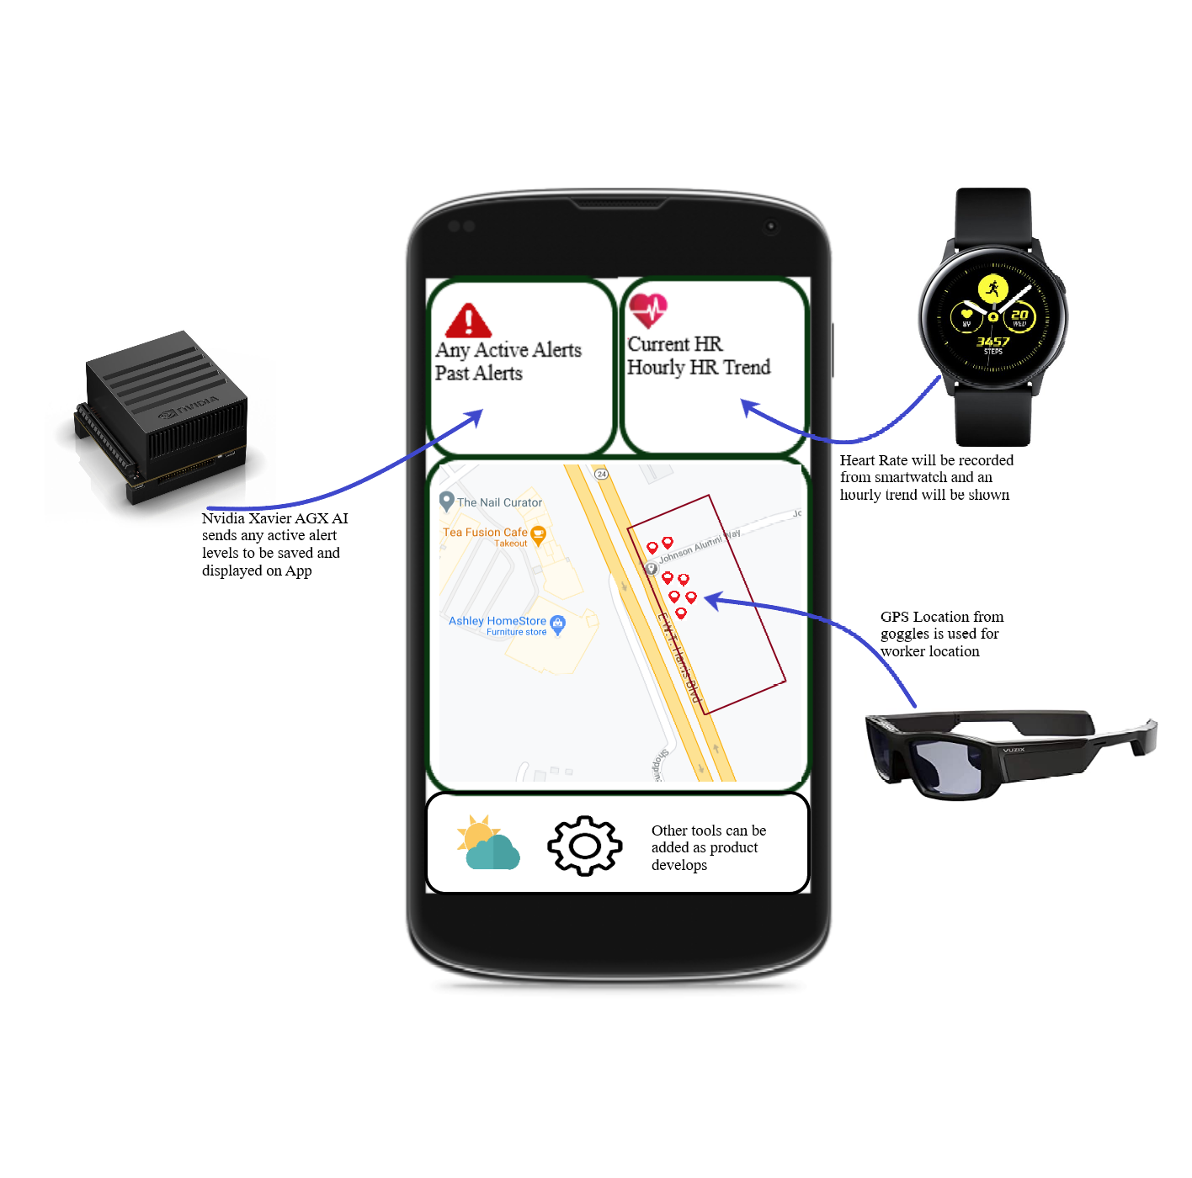
Application Development
Goal of app is to produce a useable accompaniment to our devices that will aggregate their data, provide meaningful updates to the server, and display it usefully.
These uses include:
Showing hourly trends
Showing active and past alerts for the site
Defined work area with location of devices.
The front end layout has been completed with initial back end communication connection made
Notes:
Cole
Some functionality of the app may change as development progresses
HR so that user can see if heart rate and stress are peaking during certain hours of the day. Can make adjustments to work schedule or shift management to try to counteract these trends
HR collected from workers can notice if certain times of day or areas are resulting in higher average heart rates. Management can then change work plan accordingly and as mentioned by damian the updated risk can also help to alleviate danger from these numbers.
Display location of connected devices to ensure workers aren’t straying from work zone and also if certain areas are causing higher risk numbers
Be able to define work space shown by red rectangle
The goal of our application and its development is going smoothly. The user interface has been completed in its simplest form. The application will gather the data from each of the devices on the system including the watch, the jetson, and the goggles. The application will send meaningful updates to the server and display usefully. The main components of the application include showing hourly trends of traffic with stress levels, active and past alerts, and showing a defined work area to keep the clients in a safe work area. The front end layout of the user interface is completed, while we are completely the initial back end as we speak. Our team has been working diligently to achieve a simple yet useful application for keeping the workers safe while collecting data. Now ill pass it on to Duncan to speak about our applications milestones.

Slide 15
Mobile Application Milestones
The front end user interface focuses on the alert system data, location data and the heart rate of the individual.
Current layout is completed
Next Milestones: Acquire Heart Rate from smartwatch, Integrate Location and Map API with Vuzix providing GPS location, alert values received and displayed from Xavier.
Alert data sent back to Xavier so alert level can be updated
The app has test code for connection to backend installed and is able connect to the Xavier.
Connection through the test button.
Need to connect database to collect data from other devices
Future plan for back end is to receive this information live from devices and store in a database to be displayed on front end UI
Notes:
Duncan
Database is using local database atm. Ideal goal is to use a cloud server to store data but first priority is functionality of the app. As mentioned by damian a local database will store the past alerts, HR throughout the day and display trend for user to see spikes or changes throughout the day. Having a cloud would allow access remotely through the internet but we would have to rent the storage making it more expensive than using the local DB on the tablet. The worksite most likely will only be using a LAN instead of connecting directly to the internet so data would need to be store locally before being transferred to a cloud service, unless the user is willing to use cellular data
Current plan is to use goggles as GPS location as the implementation would be easier to integrate into our system. This would allow use of java and android studio as the primary programming tool which we are more familiar with (battery life was zach)
Heart Rate will be accumulated from the Smartwatch and current HR will be displayed for connected devices. The trend of average heart rate will also be provided to show if these trends are correlated with different variables such as time of day, Work location, or even the particular type of work in that area. These trends can be used to adjust worksite locations or worker shift rotations if they are noticing that prolonged time in certain areas is affecting worker stress levels. Heart rate will be considered in danger when it starts to peak above 100BPM. !!! <- MUST MENTION SEP SUGGESTION
While the database will be storing data from the smartwatch and alert system, if the watch is reporting higher than average heart rates then this data can be used to update the alert level assessment for the work site.

Slide 16
Mobile Application Risks & Risk Management
Most immediate risk would be app displaying incorrect or out of date information
App failure/crashing causing danger and lost data
Notes:
Cole
Incorrect info could cause an incorrect adjustment or delay in schedule to be made that could cost time and money. It could also affect a worker if his stats are not valid could cause issues in his work.
Losing these trend data could mean that helpful adjustments to the project could go unnoticed and decrease the overall safety that this project is hoping to improve. Losing this data could also result in a threat level value not being properly updated which could affect the overall safety assessment of the site.
Probably worth mentioning here that at the current stage of development, it is difficult to comprehensively understand all of the risks associated with the app
Risk management of the application include worrying about the app displaying incorrect data or out of date information which can lead to issues on the management side of things. The other risk is the application failing or crashing while in the work zone causing disruption in data
Pass on to duncan.

Slide 17
Final Deliverables
Efficiency maximized (for scalability), concurrent, fluid server design to continuously (at interval) deliver messages to a single-scale system of clients
Mobile application for data collection, summarization, server updates
Notes:
Duncan
READ SLIDES FIRST
Camera Feed and AI inference for risk score generation
Not currently in our work plan but would like to be able to use camera and AI interface so that we can incorporate our work from Real time AI - NOT A DELIVERABLE

Slide 18
Questions?

